Slide 1
操作系统
主讲教师：夏莹杰
xiayingjie@zju.edu.cn

Slide 2
基本情况
课程名称：操作系统
授课时数：64学时
实验时数：16学时
面向对象：计算机科学与技术专业、软件工程等
预修课程要求：C/C++程序设计语言、数据结构、计算机组成原理

Slide 3
学习目标
操作系统是计算机最基础的系统软件，与软件、硬件均密切关联，是所有软件中最复杂的。在计算机相关专业知识体系中，操作系统课程具有承上启下的重要作用。它既是对先行课程的总结和提高，提高学生对计算机系统的整体理解，为学生学习后续专业课程打下必要的知识基础，引导学生理解大型系统软件的基本结构、模型和算法，掌握各类系统的集成应用。
本课程是培养学生计算思维能力、算法分析及设计能力、大规模软件设计与实现能力，以及计算机软硬件系统的认知、分析、设计与应用能力的重要课程。

Slide 4
课程考核
课程成绩评定：
期末考试（50%）
平时作业（5%）+课堂练习（5%）
实验报告（20%）+实验验收（20%）
每位同学独立完成2个实验
Lab0 RV64内核调试 4% 2周
Lab1 RV64内核引导 6% 2周
分组完成3个实验，每组最多2人
Lab2 RV64时钟中断处理 6% 3周
Lab3 RV64简单的进程调度实现 12% 3周
Lab4 RV64虚拟内存管理 12%
Bonus实验1个
Lab5 RV64用户模式 10%
6周

Slide 5
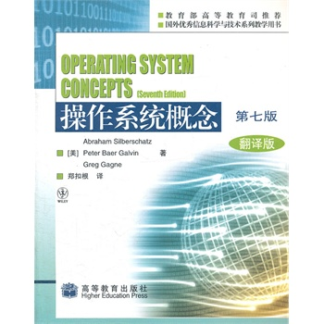
教材、参考书
“操作系统概念”教材 为主，教材：chapter1-chapter13
参考教材：
操作系统概念（翻译版，第7版）. Abraham Silberschatz. 郑扣根译. 高等教育出版社. 2010.1。
边干边学：Linux内核指导(第2版)。李善平，季江民等。浙江大学出版社。2008年4月。
参考书：
深入理解计算机系统. Randal E.Bryant等著. 龚奕利等译. 机械工业出版社. 2011.8。
操作系统考研辅导.季江民等.清华大学出版社，2010.10

Slide 6
课程网址、作业及答疑
课程教学网址：
https://courses.zju.edu.cn/course/33892/content#/
课程答疑：
xiayingjie@zju.edu.cn 13600528759
助教
刘瑞峰 15850791010 22021258@zju.edu.cn
吴逸飞 17799857027
陈天祥 18358137255

Slide 7
Chapter 1: Introduction

Slide 8
Chapter 1: Introduction
1.1 What Operating Systems Do
1.2 Computer-System Organization
1.3 Computer-System Architecture
1.4 Operating-System Operations
1.5 Resource Management
1.6 Security and Protection
1.7 Virtualization
1.8 Distributed Systems
1.9 Kernel Data Structures
1.10 Computing Environments
1.11 Free and Open-Source Operating

Slide 9
Chapter Objectives
Describe the general organization of a computer system and the role of interrupts.
Describe the components in a modern multiprocessor computer system.
Illustrate the transition from user mode to kernel mode.
Discuss how operating systems are used in various computing environments.
Provide examples of free and open-source operating systems.

Slide 10
操作系统
操作系统的名称：
监控（督）程序（系统）（Monitor)
执行系统（程序）(Executive System(program))
控制系统（程序）(Control System program))
管理程序(Supervisor, Supervisory System)
内核(Kernel)
操作系统(Operating System)

Slide 11
1.1 What Operating System Do

Slide 12
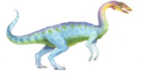
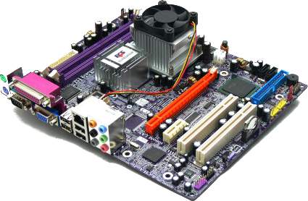
What Operating System Do?
A program that acts as an intermediary between a user of a computer and the computer hardware.
Operating system goals:
Execute user programs and make solving user problems easier.
Make the computer system convenient to use.
Use the computer hardware in an efficient manner.
Operating
System
User
Hardware

Slide 13
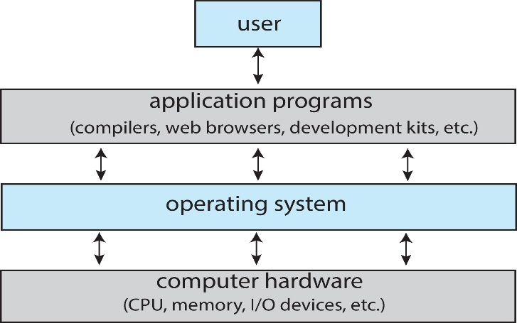
Computer System Structure
Computer system can be divided into four components
Hardware – provides basic computing resources
CPU, memory, I/O devices
Operating system
Controls and coordinates use of hardware among various applications and users
Application programs – define the ways in which the system resources are used to solve the computing problems of the users
Word processors, compilers, web browsers, database systems, video games
Users
People, machines, other computers

Slide 14
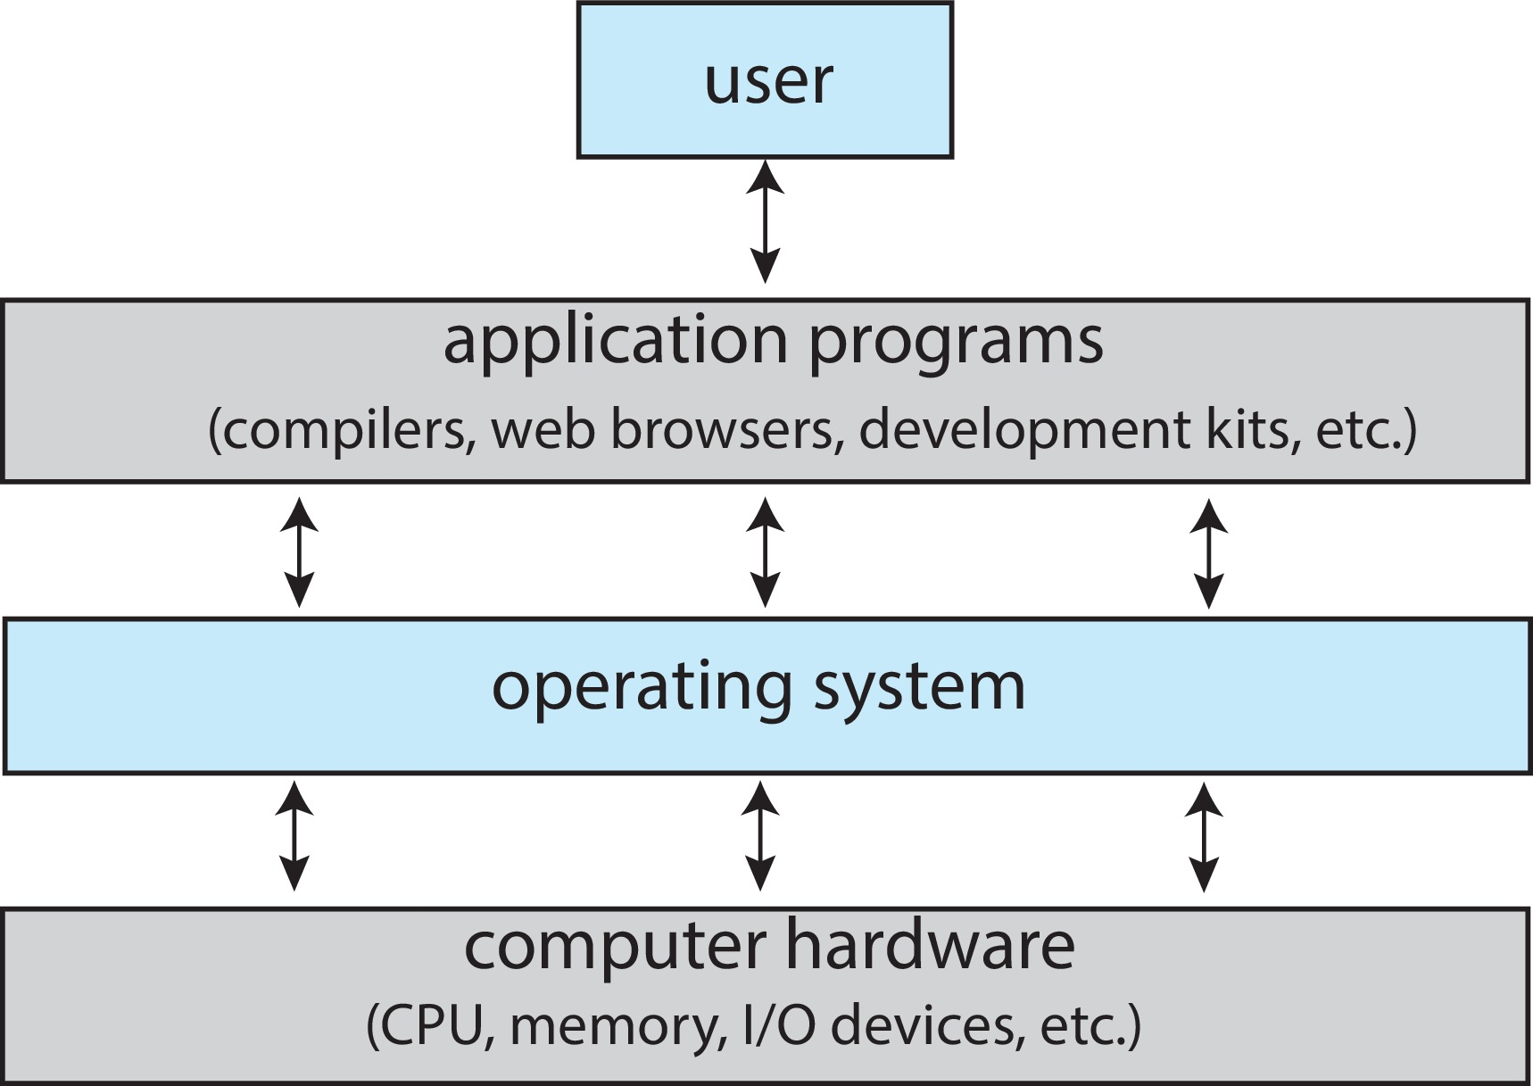
Four Components of a Computer System

Slide 15
What is Operating System ?
1、从计算机系统组成观点――操作系统是系统软件
计算机系统组成：
软件：
应用软件
系统软件（操作系统等）
硬件：
输入／输出（I／O）设备
存储器(内存)
中央处理器(CPU)

Slide 16
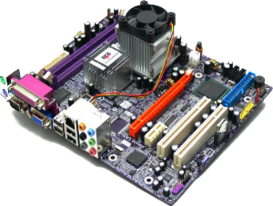
What is Operating System ?
2. User View :操作系统是用户与计算机硬件之间接口
Computer计算机硬件
PC
mainframe, or minicomputer
mobile computers
操作系统提供的接口有：
命令级接口
键盘或鼠标等命令。
Mobile user interfaces such as touch screens, voice recognition
程序级接口，它提供一组系统调用System calls ，即操作系统服务，供用户程序和其它程序调用。
Operating
System
User
Hardware

Slide 17
What is Operating System ?
3.System View:操作系统是计算机系统资源的管理者
OS is a resource allocator
Manages all resources
Decides between conflicting requests for efficient and fair resource use
OS is a control program
Controls execution of programs to prevent errors and improper use of the computer

Slide 18
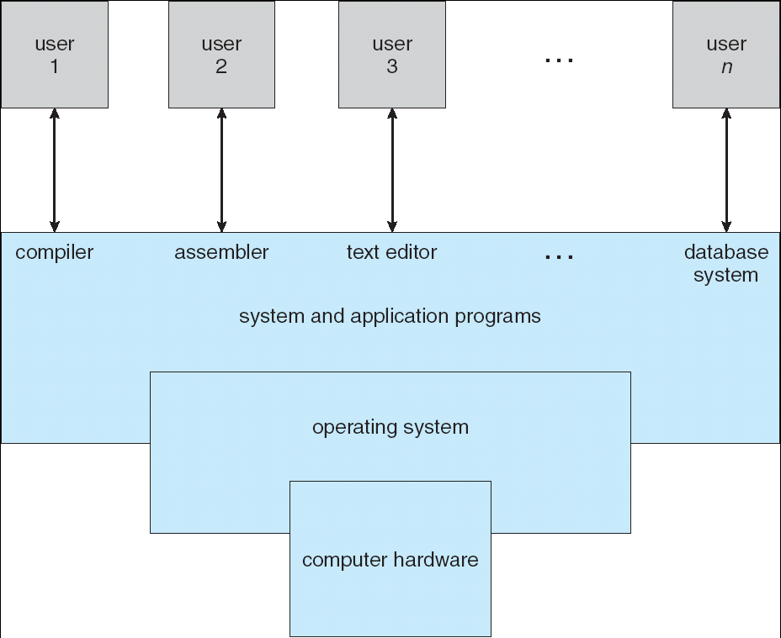
What is Operating System ?
4. 从软件分层、扩充机器的观点：操作系统是扩充裸机的第一层系统软件
Humans
Program Interface
User Programs
O.S. Interface
O.S.
Hardware Interface/ Privileged Instructions
CPU/Memory

Slide 19
Operating System Definition
5. No universally accepted definition
“it includes Everything a vendor ships when you order an operating system” is good approximation
But varies wildly
Everything else is either a system program (系统程序，ships with the operating system) or an application program，and mobile computing also include middleware
“The one program running at all times on the computer” is the kernel（内核）.
操作系统课程介绍的内容

Slide 20
Operating System Definition (Cont.)
操作系统是一组有效控制和管理计算机各种硬件和软件资源，合理的组织计算机的工作流程 ，以及方便用户的程序的集合。 ——很多中文书的描述
体现：
有效（efficient）：系统效率高，资源利用率高
（如：CPU使用率，内存、外部设备是否忙）
合理：公平，如果不公平则会产生“死锁”或“饥饿”
方便（convenience）：用户界面,编程接口

Slide 21
1.2 Computer-System Organization

Slide 22
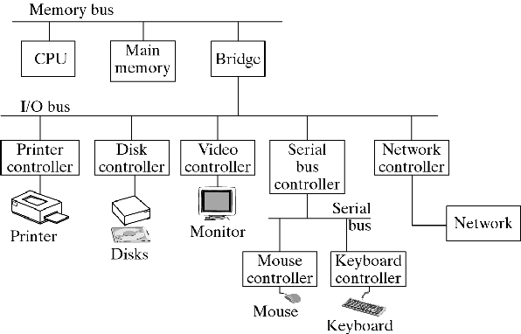
Computer System Organization
总线结构， 微型计算机是以总线为纽带来构成计算机系统，中央处理机（CPU）、存储器、 I／O设备（包括外存磁盘、磁带）都挂接在总线。
A modern computer system，总线型

Slide 23
Computer System Organization
主机型：这类计算机以存储器为中心，CPU和各种通道都与存储器相连。
a
终端
多
路
通道
存储器
选择通道
打印机
CPU
现在很少有了
A computer system，主机型

Slide 24
1.2.1 Computer-System Operation
I/O devices and the CPU can execute concurrently（并行运行）
Each device controller is in charge of a particular device type
Each device controller has a local buffer
Each device controller type has an operating system device driver to manage it
CPU moves data from/to main memory to/from local buffers
I/O is from the device to local buffer of controller
Device controller informs CPU that it has finished its operation by causing an interrupt

Slide 25
Computer Startup
bootstrap program is loaded at power-up or reboot
Typically stored in ROM or EEPROM, generally known as firmware
Initializates all aspects of system
Loads operating system kernel and starts execution

Slide 26
Common Functions of Interrupts
中断(Interrupt)：指系统发生某个异步/同步事件后,处理器暂停正在执行的程序,转去执行处理该事件程序的过程。
Interrupt transfers control to the interrupt service routine generally, through the interrupt vector（中断向量）, which contains the addresses of all the service routines.
Interrupt architecture must save the address of the interrupted instruction.

Slide 27
Common Functions of Interrupts
Incoming interrupts are disabled while another interrupt is being processed to prevent a lost interrupt.
A trap（陷入） is a software-generated interrupt caused either by an error or a user request.
An operating system is interrupt driven.

Slide 28
中断
I/O中断
中断(外中断)
时钟中断
广义中断
系统调用（陷入）
缺页异常
断点指令
其他程序性异常
(如算术溢出等)
异常(内中断)

Slide 29
中断
外部中断(interrupt)，异步中断：
外部设备所发出的I/O请求
分为可屏蔽的和不可屏蔽的两类，由一些硬件设备产生,可以在指令执行的任意时刻产生。
异常(exception)，内部中断，同步中断：
由正在执行的进程产生，一条指令终止执行后才会发出中断。
常见的异常有除零、溢出及页面异常(fault出错)等。另一种情况是使用int指令(trap陷入)，Linux使用该指令来实现系统调用。 fault与trap区别

Slide 30
Interrupt Handling（中断处理）
The operating system preserves the state of the CPU by storing registers and the program counter.
Determines which type of interrupt has occurred:
Polling 轮询
vectored interrupt system 向量化中断系统
Separate segments of code determine what action should be taken for each type of interrupt

Slide 31
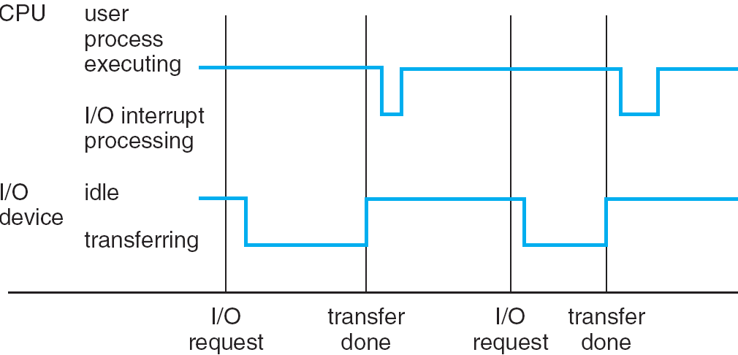
Interrupt Time line

Slide 32
1.2.2 Storage Structure
Main memory（主存） – only large storage media that the CPU can access directly.
Secondary storage（辅存） – extension of main memory that provides large nonvolatile storage capacity.
Hard Disk Drives (HDD，硬盘） – rigid metal or glass platters covered with magnetic recording material
Disk surface is logically divided into tracks, which are subdivided into sectors.
The disk controller determines the logical interaction between the device and the computer.

Slide 33
Storage Hierarchy
Storage systems organized in hierarchy.
Speed
Cost
Volatility
Caching （高速缓存）– copying information into faster storage system; main memory can be viewed as a last cache for secondary storage.

Slide 34
Caching （高速缓存）
Important principle, performed at many levels in a computer (in hardware, operating system, software)
Information in use copied from slower to faster storage temporarily
Faster storage (cache) checked first to determine if information is there
If it is, information used directly from the cache (fast)
If not, data copied to cache and used there
Cache smaller than storage being cached
Cache management is an important design problem
Cache size and replacement policy

Slide 35
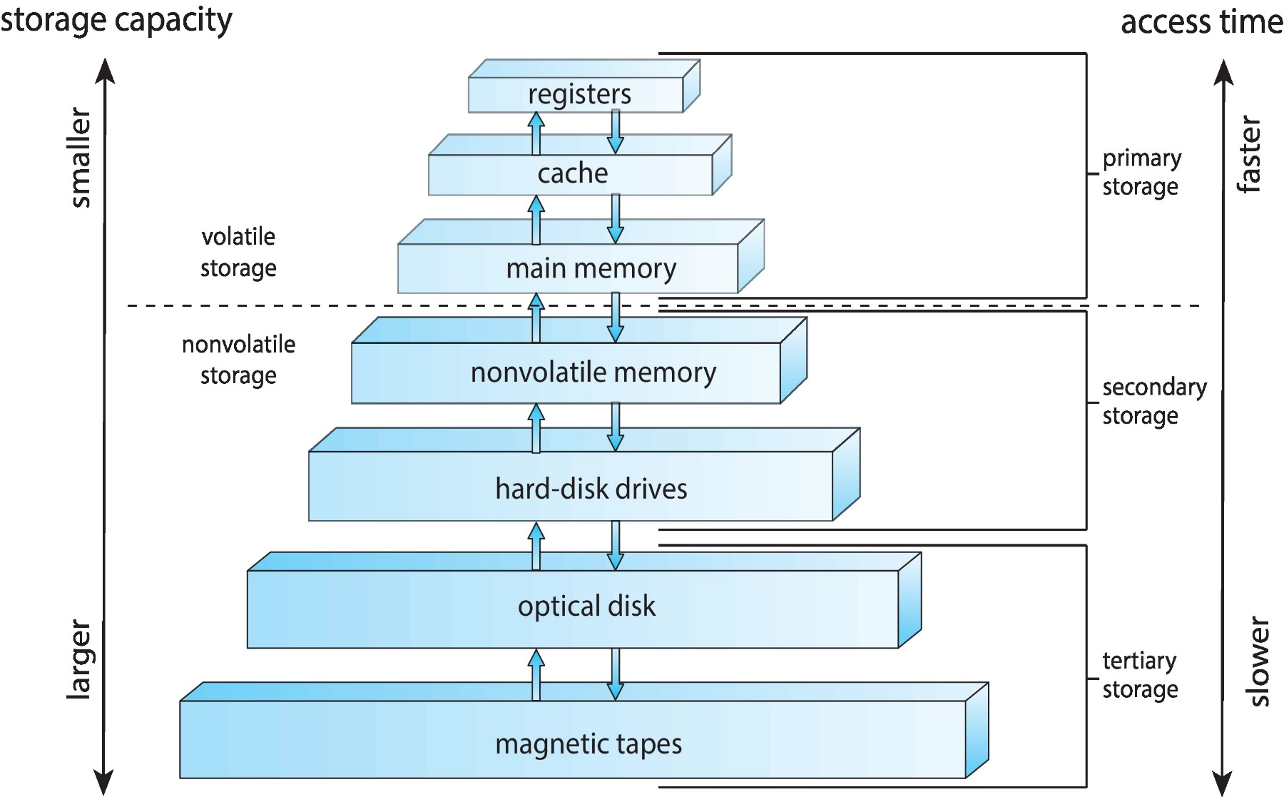
Storage-Device Hierarchy
寄存器 高速缓存
主存储器
闪存
磁盘
光盘
磁带

Slide 36
1.2.3 I/O Structure
I/O方式
程序I/O (Programmed I/O)
中断 I/O (Interrupt I/O):同步I/O和异步I/O
DMA方式
通道方式
Synchronous I/O（同步I/O ）:After I/O starts, control returns to user program only upon I/O completion.
Wait for I/O completion, two ways:
wait instruction idles the CPU until the next interrupt
wait loop (loop: jmp loop).
At most one I/O request is outstanding at a time, no simultaneous I/O processing.

Slide 37
I/O Interrupts
Asynchronous I/O （异步I/O ） : After I/O starts, control returns to user program without waiting for I/O completion.
Device-status table contains entry for each I/O device indicating its type, address, and state.
Operating system indexes into I/O device table to determine device status and to modify table entry to include interrupt.

Slide 38
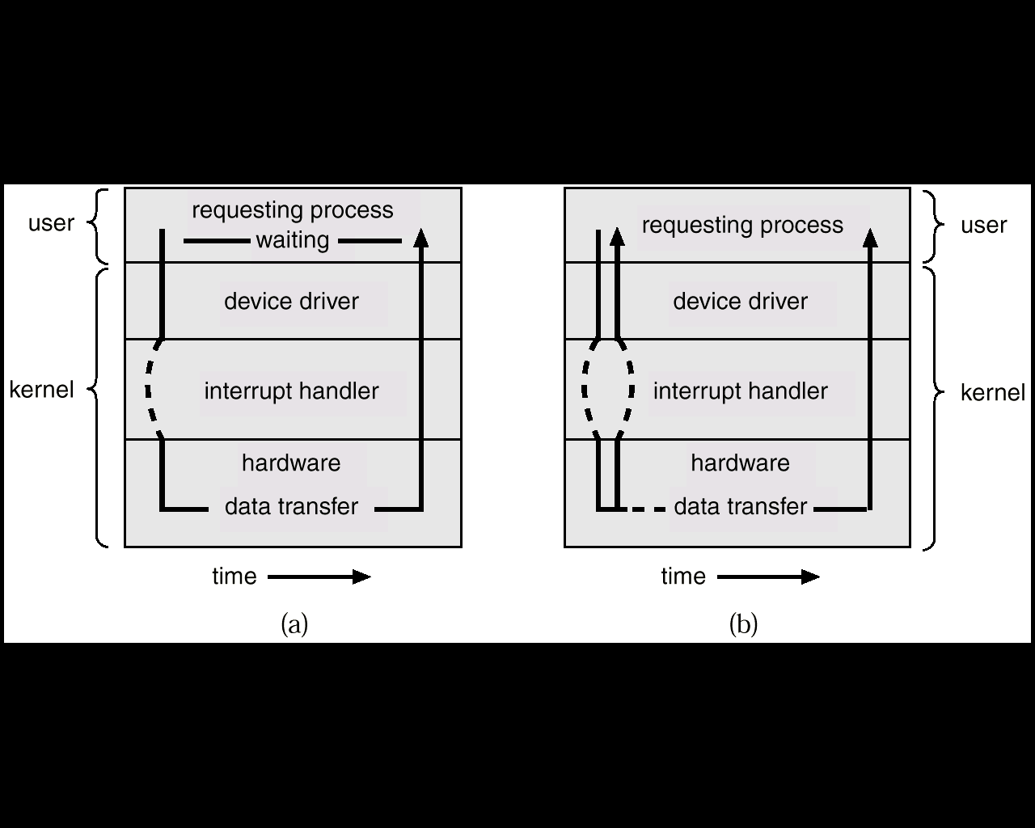
Two I/O Methods
Synchronous
Asynchronous

Slide 39
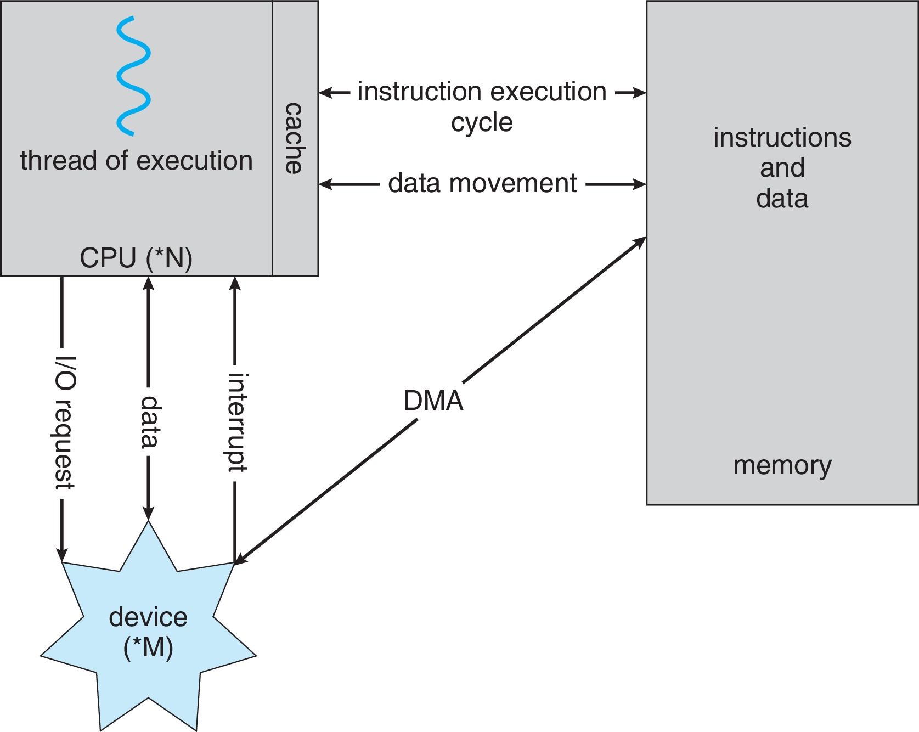
How a Modern Computer Works
A von Neumann architecture

Slide 40
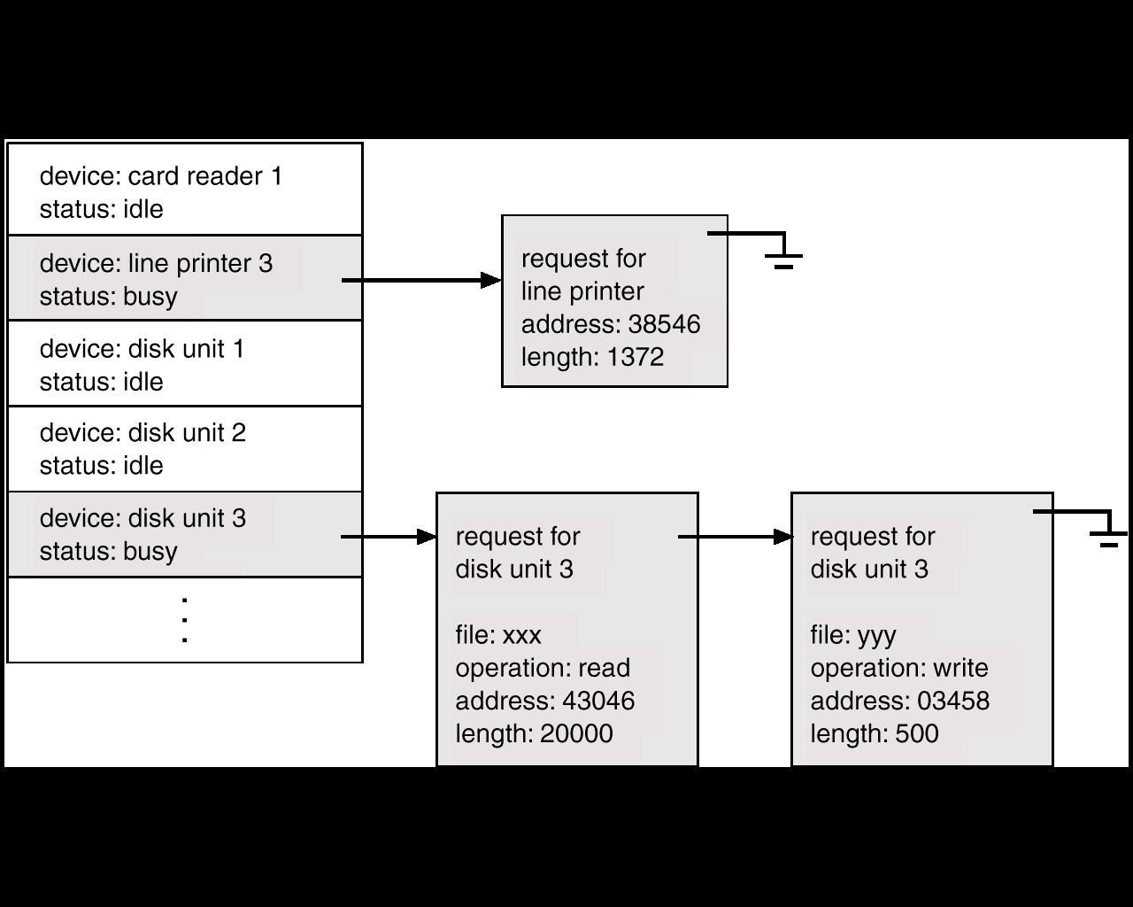
Device-Status Table

Slide 41
Direct Memory Access Structure 直接内存访问(DMA)
Used for high-speed I/O devices able to transmit information at close to memory speeds.
Device controller transfers blocks of data from buffer storage directly to main memory without CPU intervention.
Only one interrupt is generated per block, rather than the one interrupt per byte.

Slide 42
1.3 Computer-System Architecture

Slide 43
Single-Processor Systems（单处理器系统）
Many years ago, most computer systems used a single processor containing one CPU with a single processing core.
Most systems use a single general-purpose processor

Slide 44
Multiprocessor Systems（多处理器系统）
Multiprocessors systems growing in use and importance
Also known as parallel systems, tightly-coupled systems
Advantages include:
Increased throughput
Economy of scale
Increased reliability – graceful degradation or fault tolerance
Two types:
Asymmetric Multiprocessing
Symmetric Multiprocessing

Slide 45
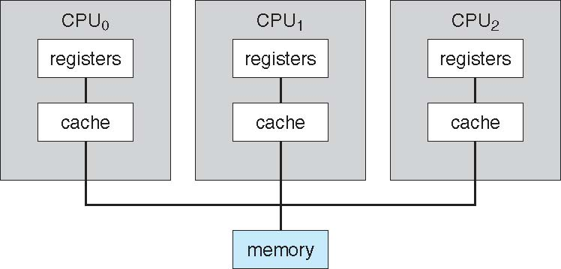
Symmetric Multiprocessing Architecture

Slide 46
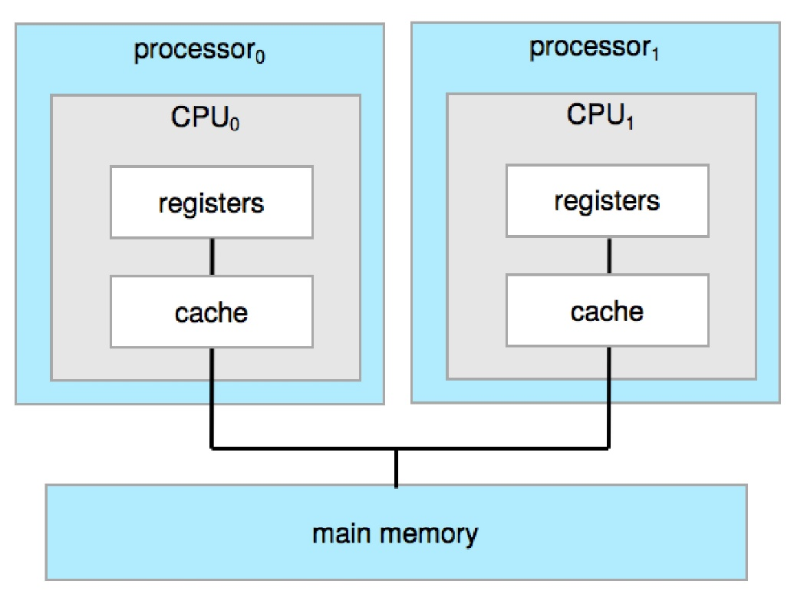
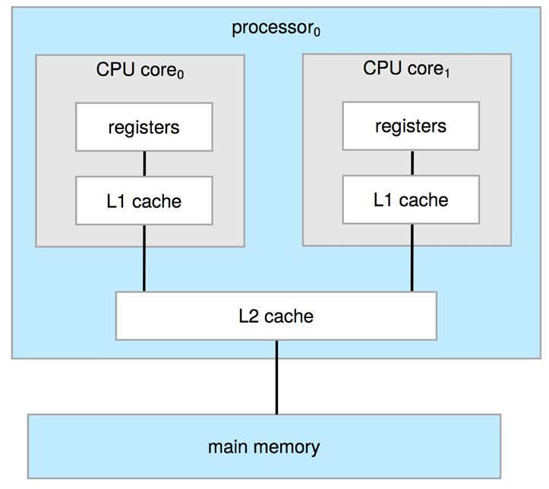
A Dual-Core Design
Multi-processor（多个芯片） and multicore（多核）
Systems containing all chips
Chassis（主板） containing multiple separate processors

Slide 47
DEFINITIONS OF COMPUTER SYSTEM COMPONENTS
CPU—The hardware that executes instructions.
Processor—A physical chip that contains one or more CPUs.
Core—The basic computation unit of the CPU.
Multicore—Including multiple computing cores on the same CPU.
Multiprocessor—Including multiple processors.
Although virtually all systems are now multicore, we use the general term
CPU when referring to a single computational unit of a computer system and
core as well as multicore when specifically referring to one or more cores on
a CPU.

Slide 48
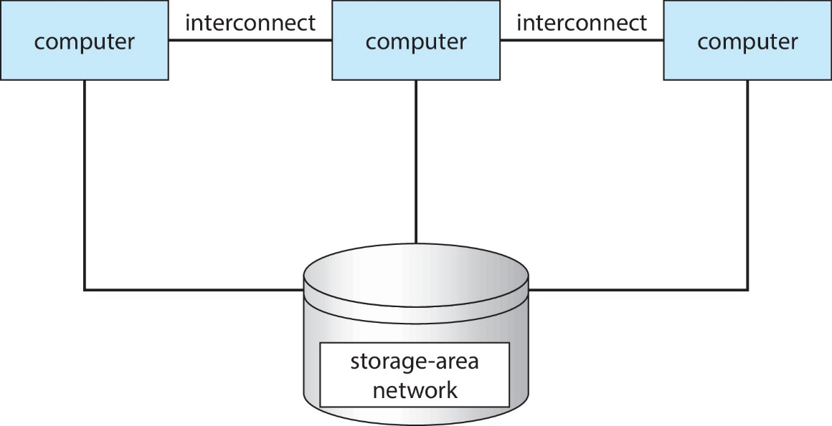
Clustered Systems集群系统
集群系统(Cluster) ：是由一组互联的主机（节点）构成统一的计算机资源，通过相应软件协调工作的计算机机群，给人以一台机器的感觉。
Usually sharing storage via a storage-area network (SAN)
Provides a high-availability service which survives failures
Asymmetric clustering（非对称集群） has one machine in hot-standby mode
Symmetric clustering （对称集群） has multiple nodes running applications, monitoring each other

Slide 49
Clustered Systems
Some clusters are for high-performance computing (HPC，高性能计算)
Applications must be written to use parallelization
Some have distributed lock manager (DLM，分布式锁管理器) to avoid conflicting operations
Other forms of cluster:parallel cluster, cluster over a WAN。
Cluster technology is changing rapidly.
Some cluster products support thousands of systems in a cluster, as well as clustered nodes that are separated by miles.
Storage-Area Network ,SAN存储区域网.

Slide 50
1.4 Operating-System Operations (操作系统的执行)

Slide 51
Operating-System Operations
Interrupt driven by hardware
Software error or request creates exception（异常） or trap（陷入）
Division by zero, request for operating system service
Other process problems include infinite loop, processes modifying each other or the operating system

Slide 52
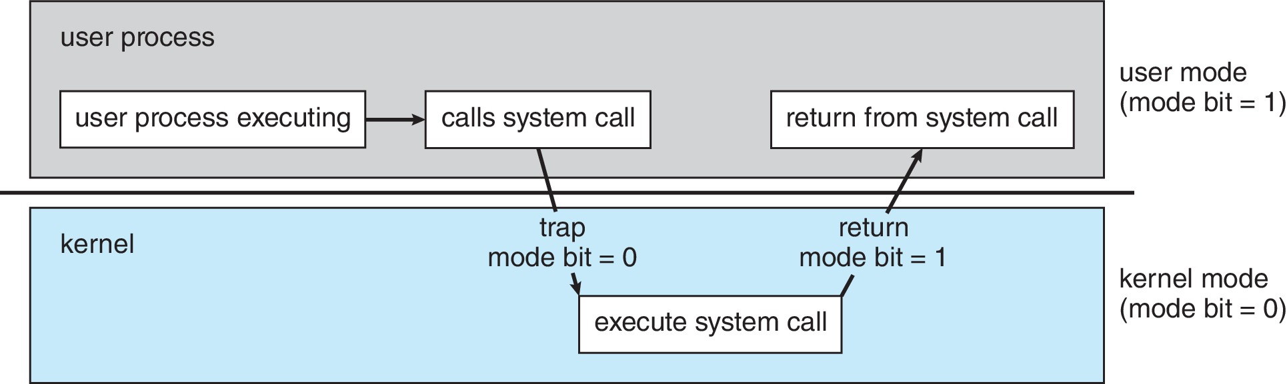
Operating-System Operations
Dual-mode operation allows OS to protect itself and other system components
User mode（用户模式，用户态） and kernel mode (also monitor mode or system mode or supervisor mode or privileged mode) （内核模式，内核态）
用户态：执行用户程序时
内核态（管态、核心态、系统态、特权模式）：执行操作系统程序时
i386支持Ring0-Ring3
重要概念

Slide 53
内核态与用户态
内核态与用户态之间的区别
内核态
能够访问所有系统资源，可以执行特权指令，可以直接操作和管理硬件设备。
操作系统内核程序运行在内核态下
使用内核栈
用户态
只能访问属于它的存储空间和普通寄存器，只能执行普通指令。
用户程序以及操作系统核外服务程序运行在用户态下
使用用户栈

Slide 54
Privileged instructions
Privileged instructions can be issued only in monitor mode.
特权指令：不允许用户程序中直接使用的指令。例如：I/O指令、设置时钟、设置控制寄存器等指令都是特权指令。
非特权指令:用户程序中所使用的指令。

Slide 55
Operating-System Operations
Timer（定时器） to prevent infinite loop / process hogging resources
Set interrupt after specific period
Operating system decrements counter
When counter zero generate an interrupt
Set up before scheduling process to regain control or terminate program that exceeds allotted time

Slide 56
1.5 Resource Management (资源管理)

Slide 57
操作系统功能部件
进程管理 Process Management
主存管理 Main Memory Management
文件系统管理 File-System Management
大容量储存管理 Mass-Storage Management
高速缓存管理 Cache Management
I/O系统管理 I/O System Management

Slide 58
Process Management
A process is a program in execution. It is a unit of work within the system. Program is a passive entity, process is an active entity.
Process needs resources to accomplish its task
CPU, memory, I/O, files
Initialization data
Process termination requires reclaim of any reusable resources
Single-threaded process has one program counter specifying location of next instruction to execute
Process executes instructions sequentially, one at a time, until completion
Multi-threaded process has one program counter per thread
Typically system has many processes, some user, some operating system running concurrently on one or more CPUs
Concurrency by multiplexing the CPUs among the processes / threads

Slide 59
Process Management Activities
The operating system is responsible for the following activities in connection with process management:
Creating and deleting both user and system processes
Suspending and resuming processes
Providing mechanisms for process synchronization
Providing mechanisms for process communication
Providing mechanisms for deadlock handling

Slide 60
Memory Management
To execute a program all (or part) of the instructions must be in memory
All (or part) of the data that is needed by the program must be in memory
Memory management determines what is in memory and when
Optimizing CPU utilization and computer response to users
Memory management activities
Keeping track of which parts of memory are currently being used and by whom
Deciding which processes (or parts thereof) and data to move into and out of memory
Allocating and deallocating memory space as needed

Slide 61
File-system Management
OS provides uniform, logical view of information storage
Abstracts physical properties to logical storage unit - file
Each medium is controlled by device (i.e., disk drive, tape drive)
Varying properties include access speed, capacity, data-transfer rate, access method (sequential or random)
File-System management
Files usually organized into directories
Access control on most systems to determine who can access what
OS activities include
Creating and deleting files and directories
Primitives to manipulate files and directories
Mapping files onto secondary storage
Backup files onto stable (non-volatile) storage media

Slide 62
Mass-Storage Management
Usually disks used to store data that does not fit in main memory or data that must be kept for a “long” period of time
Proper management is of central importance
Entire speed of computer operation hinges on disk subsystem and its algorithms
OS activities
Mounting and unmounting
Free-space management
Storage allocation
Disk scheduling
Partitioning
Protection
Some storage need not be fast
Tertiary storage includes optical storage, magnetic tape
Still must be managed – by OS or applications

Slide 63
Caching
Important principle, performed at many levels in a computer (in hardware, operating system, software)
Information in use copied from slower to faster storage temporarily
Faster storage (cache) checked first to determine if information is there
If it is, information used directly from the cache (fast)
If not, data copied to cache and used there
Cache smaller than storage being cached
Cache management important design problem
Cache size and replacement policy

Slide 64
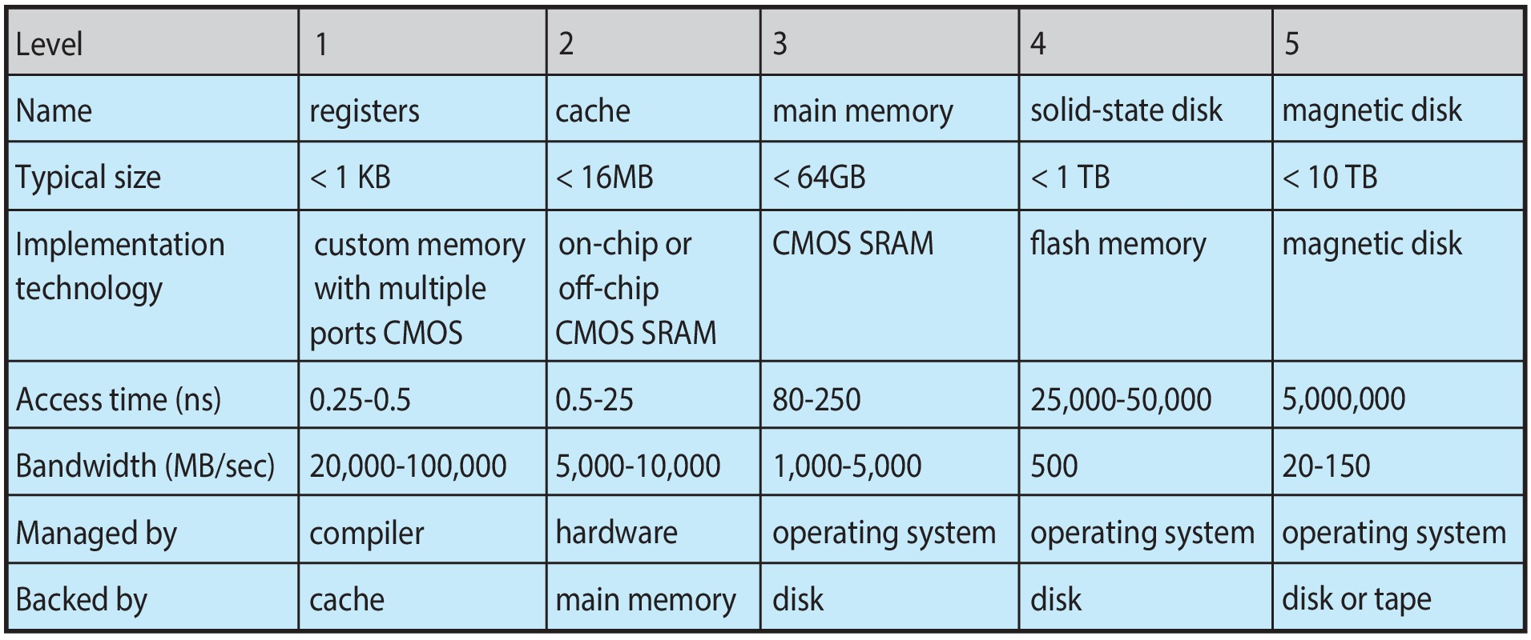
Characteristics of Various Types of Storage
Movement between levels of storage hierarchy can be explicit or implicit

Slide 65
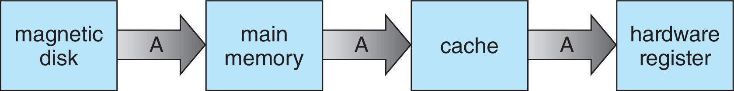
Migration of data “A” from Disk to Register
Multitasking environments must be careful to use most recent value, no matter where it is stored in the storage hierarchy
Multiprocessor environment must provide cache coherency in hardware such that all CPUs have the most recent value in their cache
Distributed environment situation even more complex
Several copies of a datum can exist
Various solutions covered in Chapter 19

Slide 66
I/O Subsystem
One purpose of OS is to hide peculiarities of hardware devices from the user
I/O subsystem responsible for
Memory management of I/O including buffering (storing data temporarily while it is being transferred), caching (storing parts of data in faster storage for performance), spooling (the overlapping of output of one job with input of other jobs)
General device-driver interface
Drivers for specific hardware devices

Slide 67
1.6 Security and Protection (安全和保护)

Slide 68
Protection and Security
Protection – any mechanism for controlling access of processes or users to resources defined by the OS
Security – defense of the system against internal and external attacks
Huge range, including denial-of-service, worms, viruses, identity theft, theft of service
Systems generally first distinguish among users, to determine who can do what
User identities (user IDs, security IDs) include name and associated number, one per user
User ID then associated with all files, processes of that user to determine access control
Group identifier (group ID) allows set of users to be defined and controls managed, then also associated with each process, file
Privilege escalation allows user to change to effective ID with more rights

Slide 69
1.7 Virtualization (虚拟化)

Slide 70
Virtualization
Allows operating systems to run applications within other OSes
Vast and growing industry
Emulation used when source CPU type different from target type (i.e. PowerPC to Intel x86)
Generally slowest method
When computer language not compiled to native code – Interpretation
Virtualization – OS natively compiled for CPU, running guest OSes also natively compiled
Consider VMware running WinXP guests, each running applications, all on native WinXP host OS
VMM (virtual machine Manager) provides virtualization services

Slide 71
Virtualization (cont.)
Use cases involve laptops and desktops running multiple OSes for exploration or compatibility
Apple laptop running Mac OS X host, Windows as a guest
Developing apps for multiple OSes without having multiple systems
QA testing applications without having multiple systems
Executing and managing compute environments within data centers
VMM can run natively, in which case they are also the host
There is no general purpose host then (VMware ESX and Citrix XenServer)

Slide 72
Computing Environments - Virtualization

Slide 73
1.8 Distributed Systems (分布式系统)

Slide 74
Distributed Systems
Distributed computing
Collection of separate, possibly heterogeneous, systems networked together
Network is a communications path, TCP/IP most common
Local Area Network (LAN)
Wide Area Network (WAN)
Metropolitan Area Network (MAN)
Personal Area Network (PAN)
Network Operating System provides features between systems across network
Communication scheme allows systems to exchange messages
Illusion of a single system

Slide 75
1.9 Kernel Data Structures (内核数据结构)

Slide 76
Kernel Data Structures
Many similar to standard programming data structures
Singly linked list
Doubly linked list
Circular linked list

Slide 77
Kernel Data Structures
Binary search tree left <= right
Search performance is O(n)
Balanced binary search tree is O(lg n)

Slide 78
Kernel Data Structures
Hash function can create a hash map
Bitmap – string of n binary digits representing the status of n items
Linux data structures defined in include files <linux/list.h>, <linux/kfifo.h>, <linux/rbtree.h>

Slide 79
1.10 Computing Environments(计算环境)
Traditional（传统计算）
Mobile （移动计算）
Client-Server（客户机-服务器计算）
Peer-to-Peer（点对点计算）
Virtualization（虚拟化计算）
Cloud Computing（云计算）
Real-Time Embedded Systems(实时嵌入式系统)
国内操作系统现状

Slide 80
一、Traditional
Stand-alone general purpose machines
But blurred as most systems interconnect with others (i.e. the Internet)
Portals provide web access to internal systems
Network computers (thin clients) are like Web terminals
Mobile computers interconnect via wireless networks
Networking becoming ubiquitous – even home systems use firewalls to protect home computers from Internet attacks

Slide 81
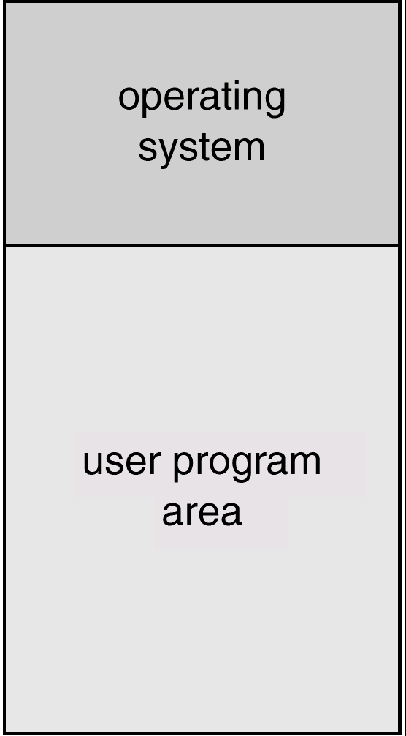
1. Mainframe Systems大型机系统
大型机（主机）的操作系统有：批处理系统、分时系统
Batch System批处理系统
单道批处理系统
多道批处理系统

Slide 82
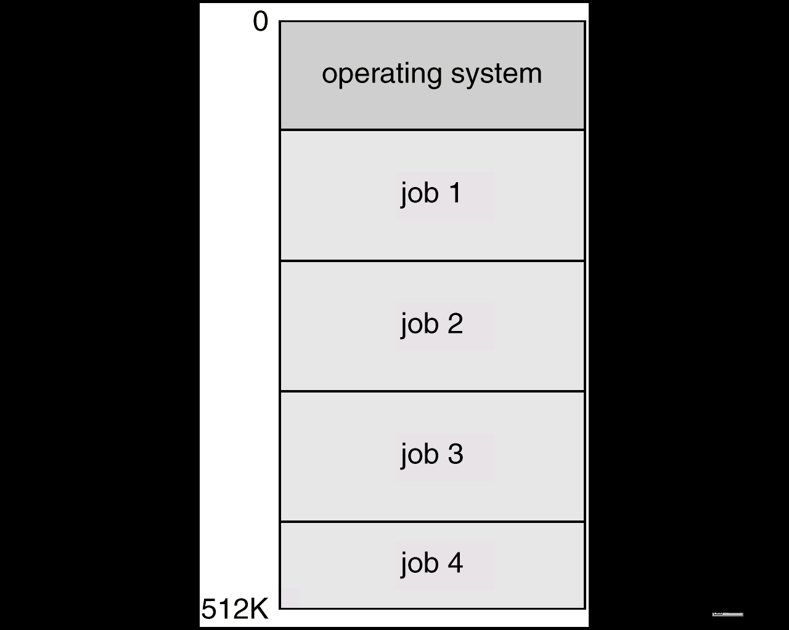
Multiprogrammed Systems
重要概念
Multiprogramming（多道程序）
Several jobs are kept in main memory at the same time, and the CPU is multiplexed among them.

Slide 83
2. Time-Sharing Systems分时系统
Timesharing (multitasking,多任务) is logical extension in which CPU switches jobs so frequently that users can interact with each job while it is running, creating interactive computing
所谓分时是指多个用户分时共享使用同一台计算机，也就是说把计算机的系统资源（尤其是CPU时间）进行时间上分割，即将整个工作时间分成一个个的时间片，每个时间片分给一个用户使用，这样将CPU工作时间分别提供给多个用户使用，每个用户依次地轮流且使用一个时间片。
1961年11月MIT实现了第一个分时系统CTSS

Slide 84
响应时间
响应时间是分时系统的重要指标，它是用户发出终端命令到系统作出响应的时间间隔。系统的响应时间主要是根据用户所能接受的等待时间确定的。假设分时系统中进程数(用户数)为n，每个进程的运行时间片为q，则系统的响应时间为
S＝(n-1)×q。
UNIX、Linux、Windows

Slide 85
3. Desktop Systems
Personal computers– computer system dedicated to a single user.
I/O devices– keyboards, mice, display screens, small printers. I/O
User convenience and responsiveness.
Can adopt technology developed for larger operating system’ often individuals have sole use of computer and do not need advanced CPU utilization of protection features.
May run several different types of operating systems
Windows, Mac OS X, UNIX, Linux

Slide 86
PC主要操作系统
Windows系列：DOS, Windows 3.x, Window 95/98/2000/XP/7/8/10, Windows NT/2000/2003/2008/2013/2017 server；
UNIX大家庭：BSD, Open Solaris, AIX, HP_UX , SVR4；Mac OS X， Linux。

Slide 87
二、 Mobile
Handheld smartphones, tablets, etc
What is the functional difference between them and a “traditional” laptop?
Extra feature – more OS features (GPS, gyroscope陀螺仪)
Allows new types of apps like augmented reality
Use IEEE 802.11 wireless, or cellular data networks for connectivity
智能手机、平板电脑操作系统
Android、iOS 、Windows phone

Slide 88
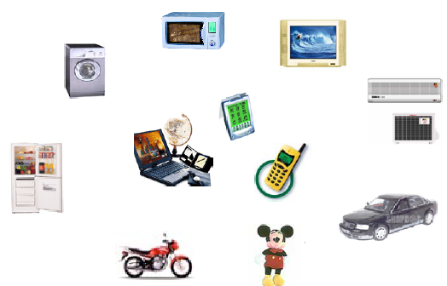
计算机应用领域
小型专用型
桌面通用型
高端服务型，高性能计算
嵌入式操作系统：Android、iOS、Windows、Linux......
桌面操作系统：
Windows、Mac OS X、Linux…
服务器操作系统：
Unix、Linux、Windows、Solaris、AIX…

Slide 89
三、Client-Server
Client-Server Computing
Dumb terminals supplanted by smart PCs
Many systems now servers, responding to requests generated by clients
Compute-server system provides an interface to client to request services (i.e., database)
File-server system provides interface for clients to store and retrieve files

Slide 90
四、 Peer-to-Peer
Another model of distributed system
P2P does not distinguish clients and servers
Instead all nodes are considered peers
May each act as client, server or both
Node must join P2P network
Registers its service with central lookup service on network, or
Broadcast request for service and respond to requests for service via discovery protocol
Examples include Napster and Gnutella, Voice over IP (VoIP) such as Skype
Blockchain technology 区块链技术

Slide 91
五、 Virtualization
Allows operating systems to run applications within other OSes
Vast and growing industry
Emulation used when source CPU type different from target type (i.e. PowerPC to Intel x86)
Generally slowest method
When computer language not compiled to native code – Interpretation
Virtualization – OS natively compiled for CPU, running guest OSes also natively compiled
Consider VMware running WinXP guests, each running applications, all on native WinXP host OS
VMM provides virtualization services

Slide 92
Virtualization
Use cases involve laptops and desktops running multiple OSes for exploration or compatibility
Apple laptop running Mac OS X host, Windows as a guest
Developing apps for multiple OSes without having multiple systems
QA testing applications without having multiple systems
Executing and managing compute environments within data centers
VMM can run natively, in which case they are also the host
There is no general purpose host then (VMware ESX and Citrix XenServer)

Slide 93
Virtualization

Slide 94
六、 Cloud Computing
Delivers computing, storage, even apps as a service across a network
Logical extension of virtualization as based on virtualization
Amazon EC2 has thousands of servers, millions of VMs, PBs of storage available across the Internet, pay based on usage

Slide 95
Cloud Computing
Many types
Public cloud （公有云）– available via Internet to anyone willing to pay
Private cloud （私有云） – run by a company for the company’s own use
Hybrid cloud （混合云）– includes both public and private cloud components
Software as a Service (SaaS，软件即服务) – one or more applications available via the Internet (i.e. word processor)
Platform as a Service (PaaS，平台即服务) – software stack ready for application use via the Internet (i.e a database server)
Infrastructure as a Service (IaaS，基础设施即服务) – servers or storage available over Internet (i.e. storage available for backup use)

Slide 96
Cloud Computing
Cloud compute environments composed of traditional OSes, plus VMMs, plus cloud management tools
Internet connectivity requires security like firewalls
Load balancers spread traffic across multiple applications

Slide 97
七、 Real-Time Embedded Systems
Real-time embedded systems most prevalent form of computers
Vary considerable, special purpose, limited purpose OS, real-time OS
Use expanding
Many other special computing environments as well
Some have OSes, some perform tasks without an OS
Real-time OS has well-defined fixed time constraints
Processing must be done within constraint
Correct operation only if constraints met

Slide 98
嵌入式系统
嵌入式系统是以应用为中心，以计算机技术为基础，采用可剪裁软硬件，适用于对功能、可靠性、成本、体积、功耗等有严格要求的专用计算机系统，用于实现对其他设备的控制、监视或管理等功能
嵌入式操作系统：运行在嵌入式系统环境中，对整个嵌入式系统以及它所操作、控制的各种部件装置等资源进行统一协调、调度和控制的系统软件

Slide 99
嵌入式操作系统
几种主流嵌入式操作系统
嵌入式Linux :
μCLinux
RT-Linux
XLinux
红旗嵌入式Linux
Montavista linux
风河linux ......
VxWorks
QNX
Windows CE
uC/OS
Palm OS
L4

Slide 100
操作系统市场格局
当前三大体系：
Unix/Linux :服务器
Windows、Mac OS X ：桌面
Android、iOS、Windows phone：手机

Slide 101
国内操作系统发展情况
我国信息系统对Windows的依赖度是全世界最高的
“核高基”重大专项
16项国家科技重大专项的第一项
核心电子器件、高端通用芯片、基础软件（二件一芯）
本质：OS、CPU
COSIX失败
1989－1997：17家单位、200多位科技人员、4000多万元
没有配套的自主硬件平台
没有配套的应用软件体系
没有产业化政策向导
没有形成支撑可持续发展的基本用户群
处于同期研制的Windows和Linux大获成功
1990：windows 3.0, 1991:Linux kernel 0.11
*麒麟操作系统

Slide 102
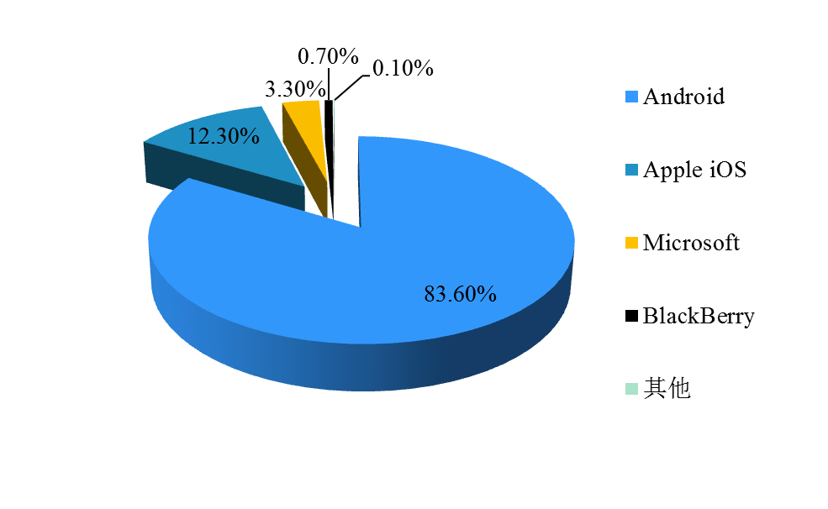
操作系统长期由国外厂商垄断
微软以及谷歌、苹果OS在国内具有绝对的垄断地位
据工信部电信研究院的调研报告，国内自主操作系统装机普遍未超过市场份额的1%
图注：2014年10月全球桌面操作系统市场份额（来源：Net Applications）
图注：2014年第三季度全球移动操作系统市场份额（来源：Strategy Analytics）

Slide 103
作为核心基础软件的操作系统长期由国外厂商垄断
据2014年2月证券日报报道，有机构对我国130万套软硬件设备的统计数据显示，采用国外产品的比例为：操作系统97.25%、数据库95.06%、服务器86.72%、数据处理设备83.38%、网络设备62.28%
去IOE化（去掉IBM的小型机、Oracle数据库、EMC存储设备）已成为国内互联网产业界（ 如阿里、百度、腾讯等）的共识，并取得显著成效。而在操作系统领域，去“WINTEL联盟”还未取得显著成效，又引来了“双A联盟（ Android+ARM）”
操作系统产品缺乏有效供给，成为国产自主替代的重要制约因素
2018年中兴通信事件有什么启发？

Slide 104
Windows为什么成功
80年代后期至90年代初期PC操作系统
Mac OS, IBM OS/2, Windows
目前Windows市场份额逾80%
成功原因
使用方便，易于操作
固定硬件平台，确保基本用户群
针对IBM PC开放硬件平台和Intel CPU特点进行针对性设计和优化
在市场利益驱动下形成了软硬件一体的产业链
硬件及外设厂商基于微软接口开发设备驱动
应用软件厂商基于微软接口开发应用系统

Slide 105
Android为什么会成功？

Slide 106
1.11 Free and Open-Source Operating Systems(自由和开源操作系统)

Slide 107
Open-Source Operating Systems
Operating systems made available in source-code format rather than just binary closed-source
Counter to the copy protection and Digital Rights Management (DRM) movement
Started by Free Software Foundation (FSF), which has “copyleft” GNU Public License (GPL)
Examples include GNU/Linux and BSD UNIX (including core of Mac OS X), and many more
Can use VMM like VMware Player (Free on Windows), Virtualbox (open source and free on many platforms - http://www.virtualbox.com)
Use to run guest operating systems for exploration
在Linux概述中介绍

Slide 108
The Study of Operating Systems
There has never been a more interesting time to study operating systems, and it has never been easier. The open-source movement has overtaken operating systems, causing many of them to be made available in both source and binary (executable) format. The list of operating systems available in both formats includes Linux, BUSD UNIX, Solaris, and part of macOS. The availability of source code allows us to study operating systems from the inside out. Questions that we could once answer only by looking at documentation or the behavior of an operating system we can now answer by examining the code itself.
Operating systems that are no longer commercially viable have been open-sourced as well, enabling us to study how systems operated in a time of fewer CPU, memory, and storage resources. An extensive but incomplete list of open-source operating-system projects is available from http://dmoz.org/Computers/Software/Operating_Systems/Open_Source/

Slide 109
The Study of Operating Systems
In addition, the rise of virtualization as a mainstream (and frequently free) computer function makes it possible to run many operating systems on top of one core system. For example, Vmware (http://www.vmware.com) providesa free “player” for Windows on which hundreds of free “virtual appliances” can run. Virtualbox (http://www.virtualbox.com) provides a free, open-source virtual machine manager on many operating systems. Using such tools, students can try out hundreds of operating systems without dedicated hardware.
The advent of open-source operating systems has also made it easier to make the move from student to operating-system developer. With some knowledge, some effort, and an Internet connection, a student can even create a new operating-system distribution. Just a few years ago, it was difficult or mpossible to get access to source code. Now, such access is limited only by
how much interest, time, and disk space a student has.

Slide 110
Summary
An Operating System (from here on OS) is a software (a program) that performs two functions:
it extends the “use” of the computer hardware and
it manage the computer system resources

Slide 111
Summary
batch system(批处理系统) 、time-sharing system （分时系统）、real-time system （实时系统）
interrupt（中断）、trap（陷入）
kernel（内核）、microkernel（微内核）、monolithic kernel（单内核）
multiprogramming（多道程序设计）
privileged instruction（特权指令）
kernel mode（内核模式）、user mode（用户模式）
symmetric multiprocessing（SMP 对称多处理器）
swapping（交换）
system call（系统调用）
Cloud Computing （云计算）

Slide 112
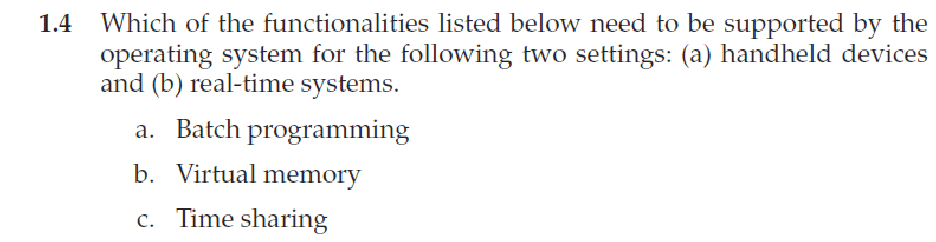
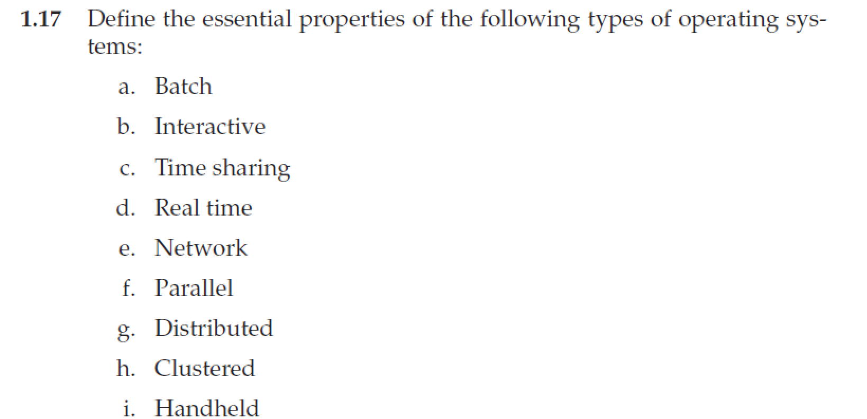
Homework
书后习题1.4，1.17
9月25日晚上12点前发邮件给TA（刘瑞峰，22021258@zju.edu.cn）
文件名以“学号-姓名-作业x”命名，例如“3170100000-张三-作业1”

Slide 113
End of Chapter 1

